Slide 1
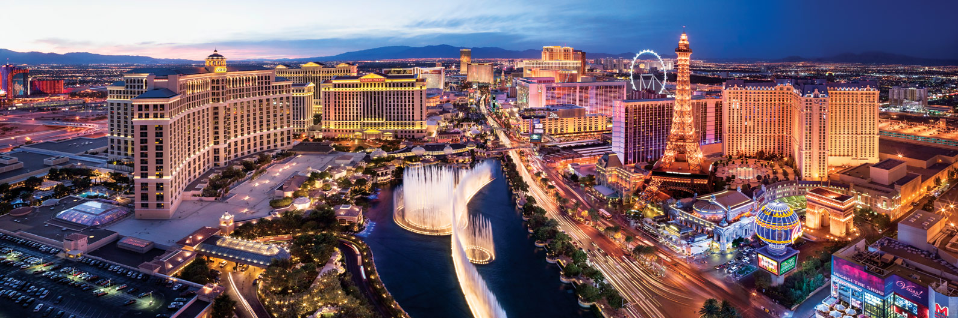

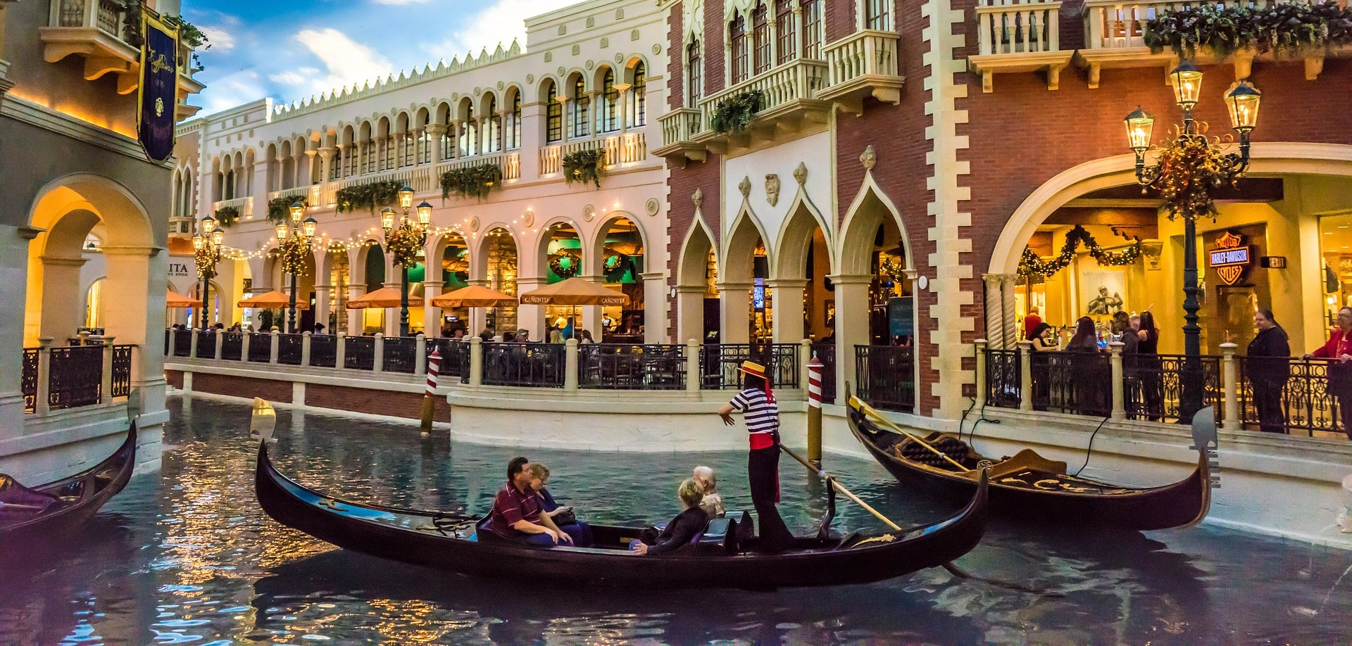
TEAM 8
Join us on our trip to Las Vegas
Kyle Blackburn, Hongyang Liu, Lyufan Pan, Mansi Tolia & Fernanda Lin

Slide 2
RECAP

Slide 3
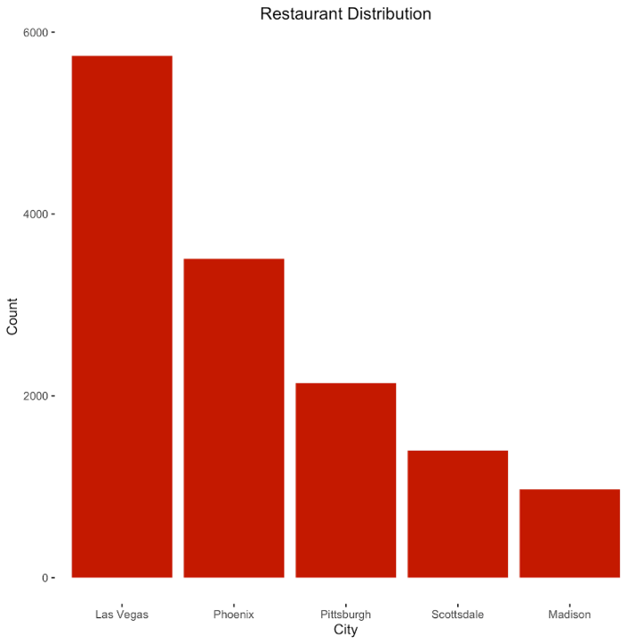
Why Las Vegas?
Las Vegas has the most number of restaurants with higher than average number of check-ins.
Notes:
This time we decided to narrow down what’s that about

Slide 4
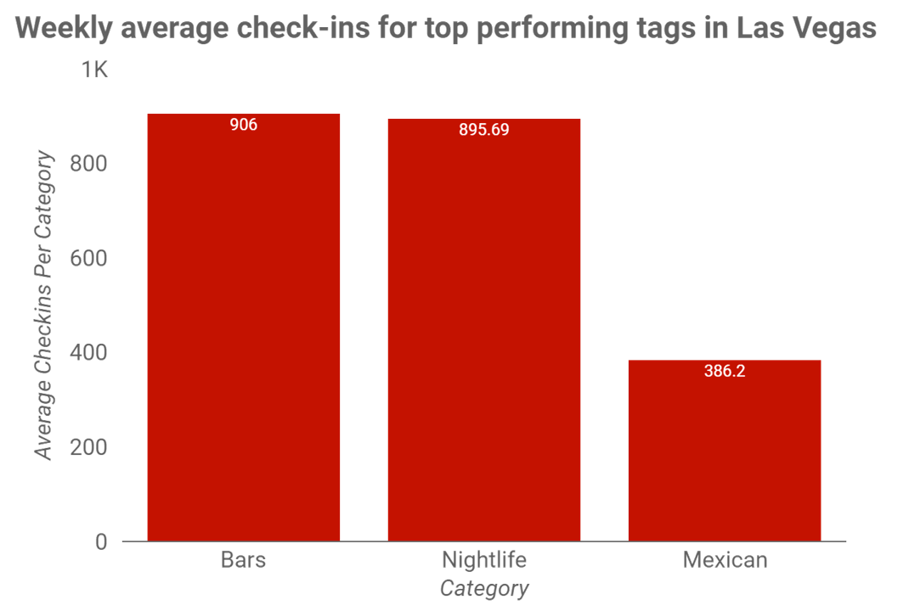
Recommendations for Las Vegas
We had recommended a restaurant which would serve Mexican food, have a bar and host nightlife.

Slide 5
Focuses: Location & Hours of Operation
Restaurant’s "success" = average stars (ratings out of five) and total check-ins
Are restaurants' success affected by their proximity to the next most frequent business type in the same area?
How do hours of operation affect the performance of a restaurant?
Notes:
A restaurant that continuously receives high star-ratings and lots of check-ins would ideally be in business for longer than one that lacks the same amount of user feedback.
We measure success base on average star rating and total check-ins

Slide 6
LOCATION?

Slide 7
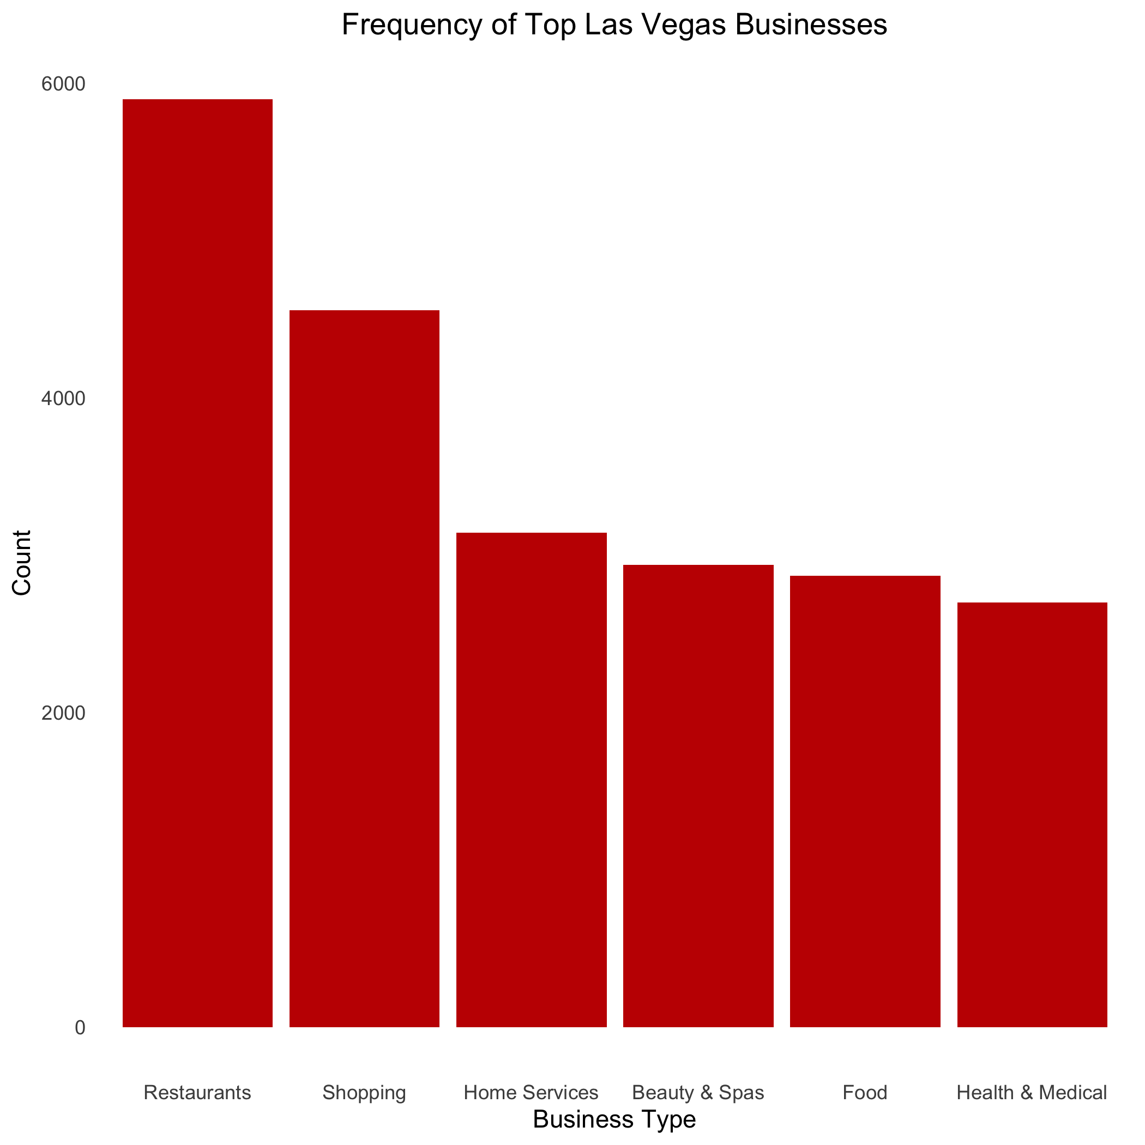
Most Common Business Types
Shopping is the second most frequent business type found in Las vegas after restaurants.

Slide 8
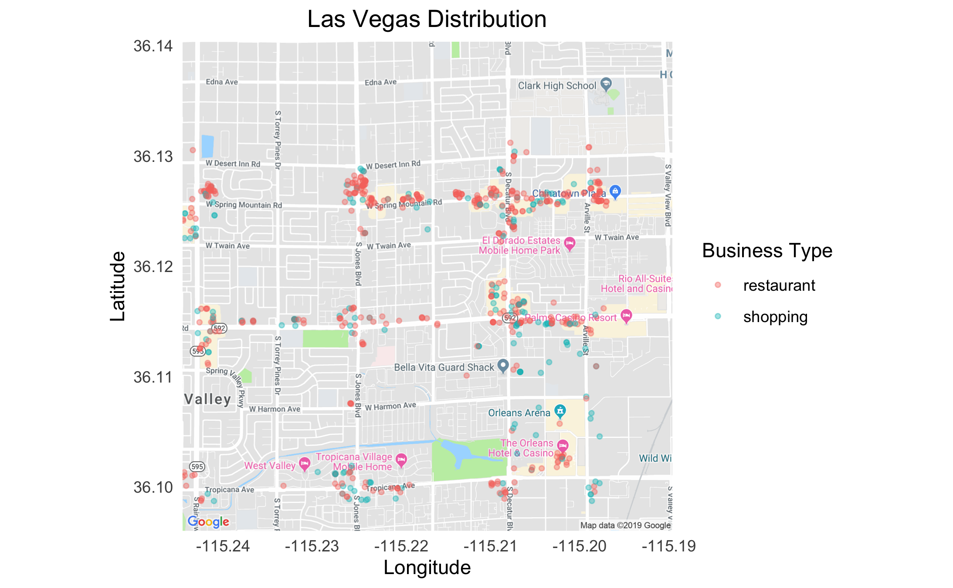
Restaurant & Shopping Distribution

Slide 9
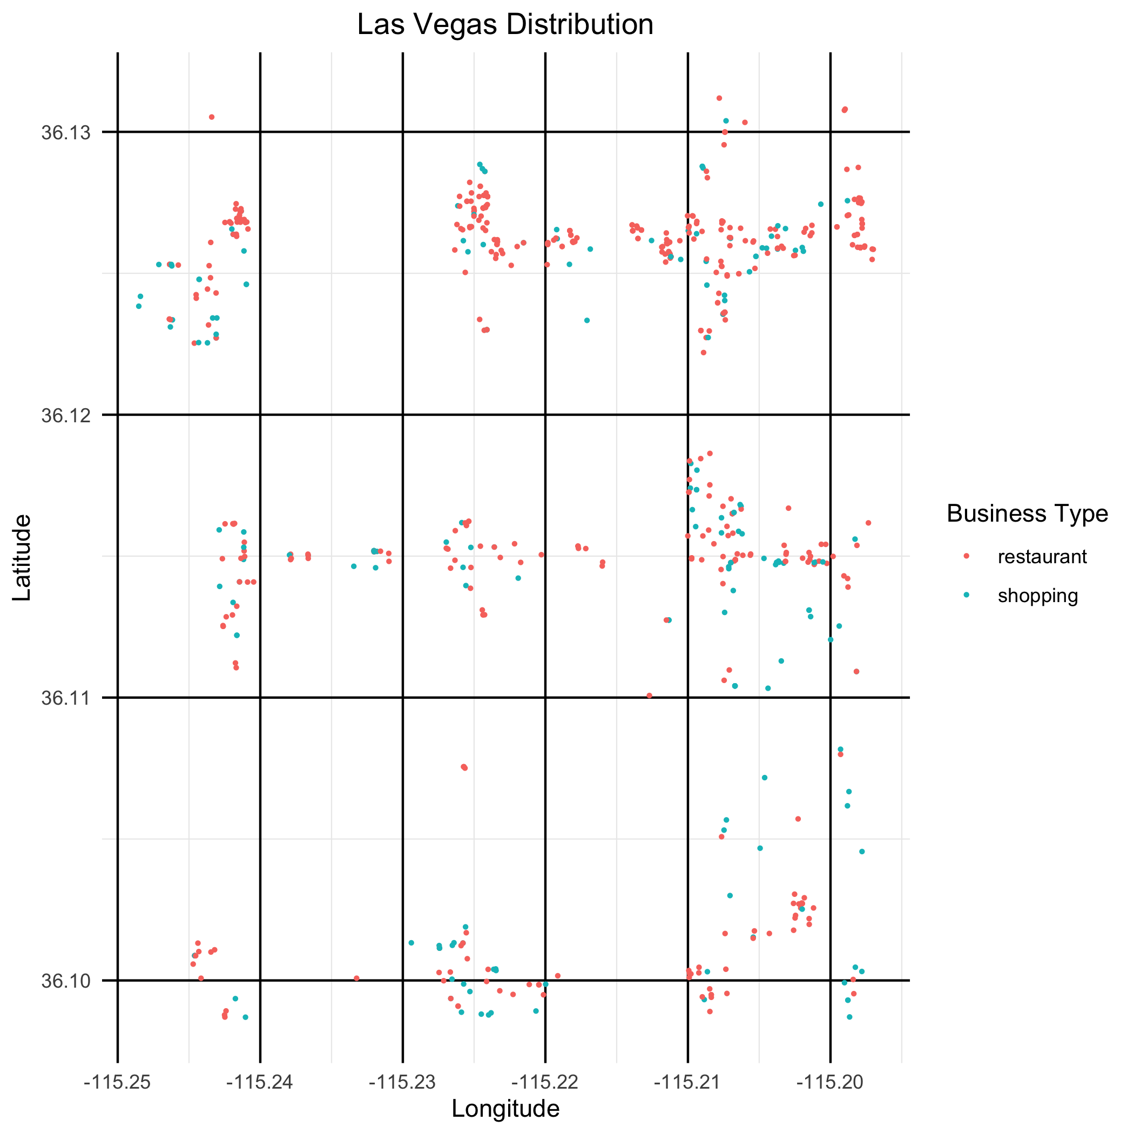
Restaurant & Shopping Distribution

Slide 10

Raster Analysis
Distribution of “shopping” business type
Distribution of “restaurant” business type
Distribution of average star ratings for restaurants
Distribution of total number of check-ins for restaurants

Slide 11
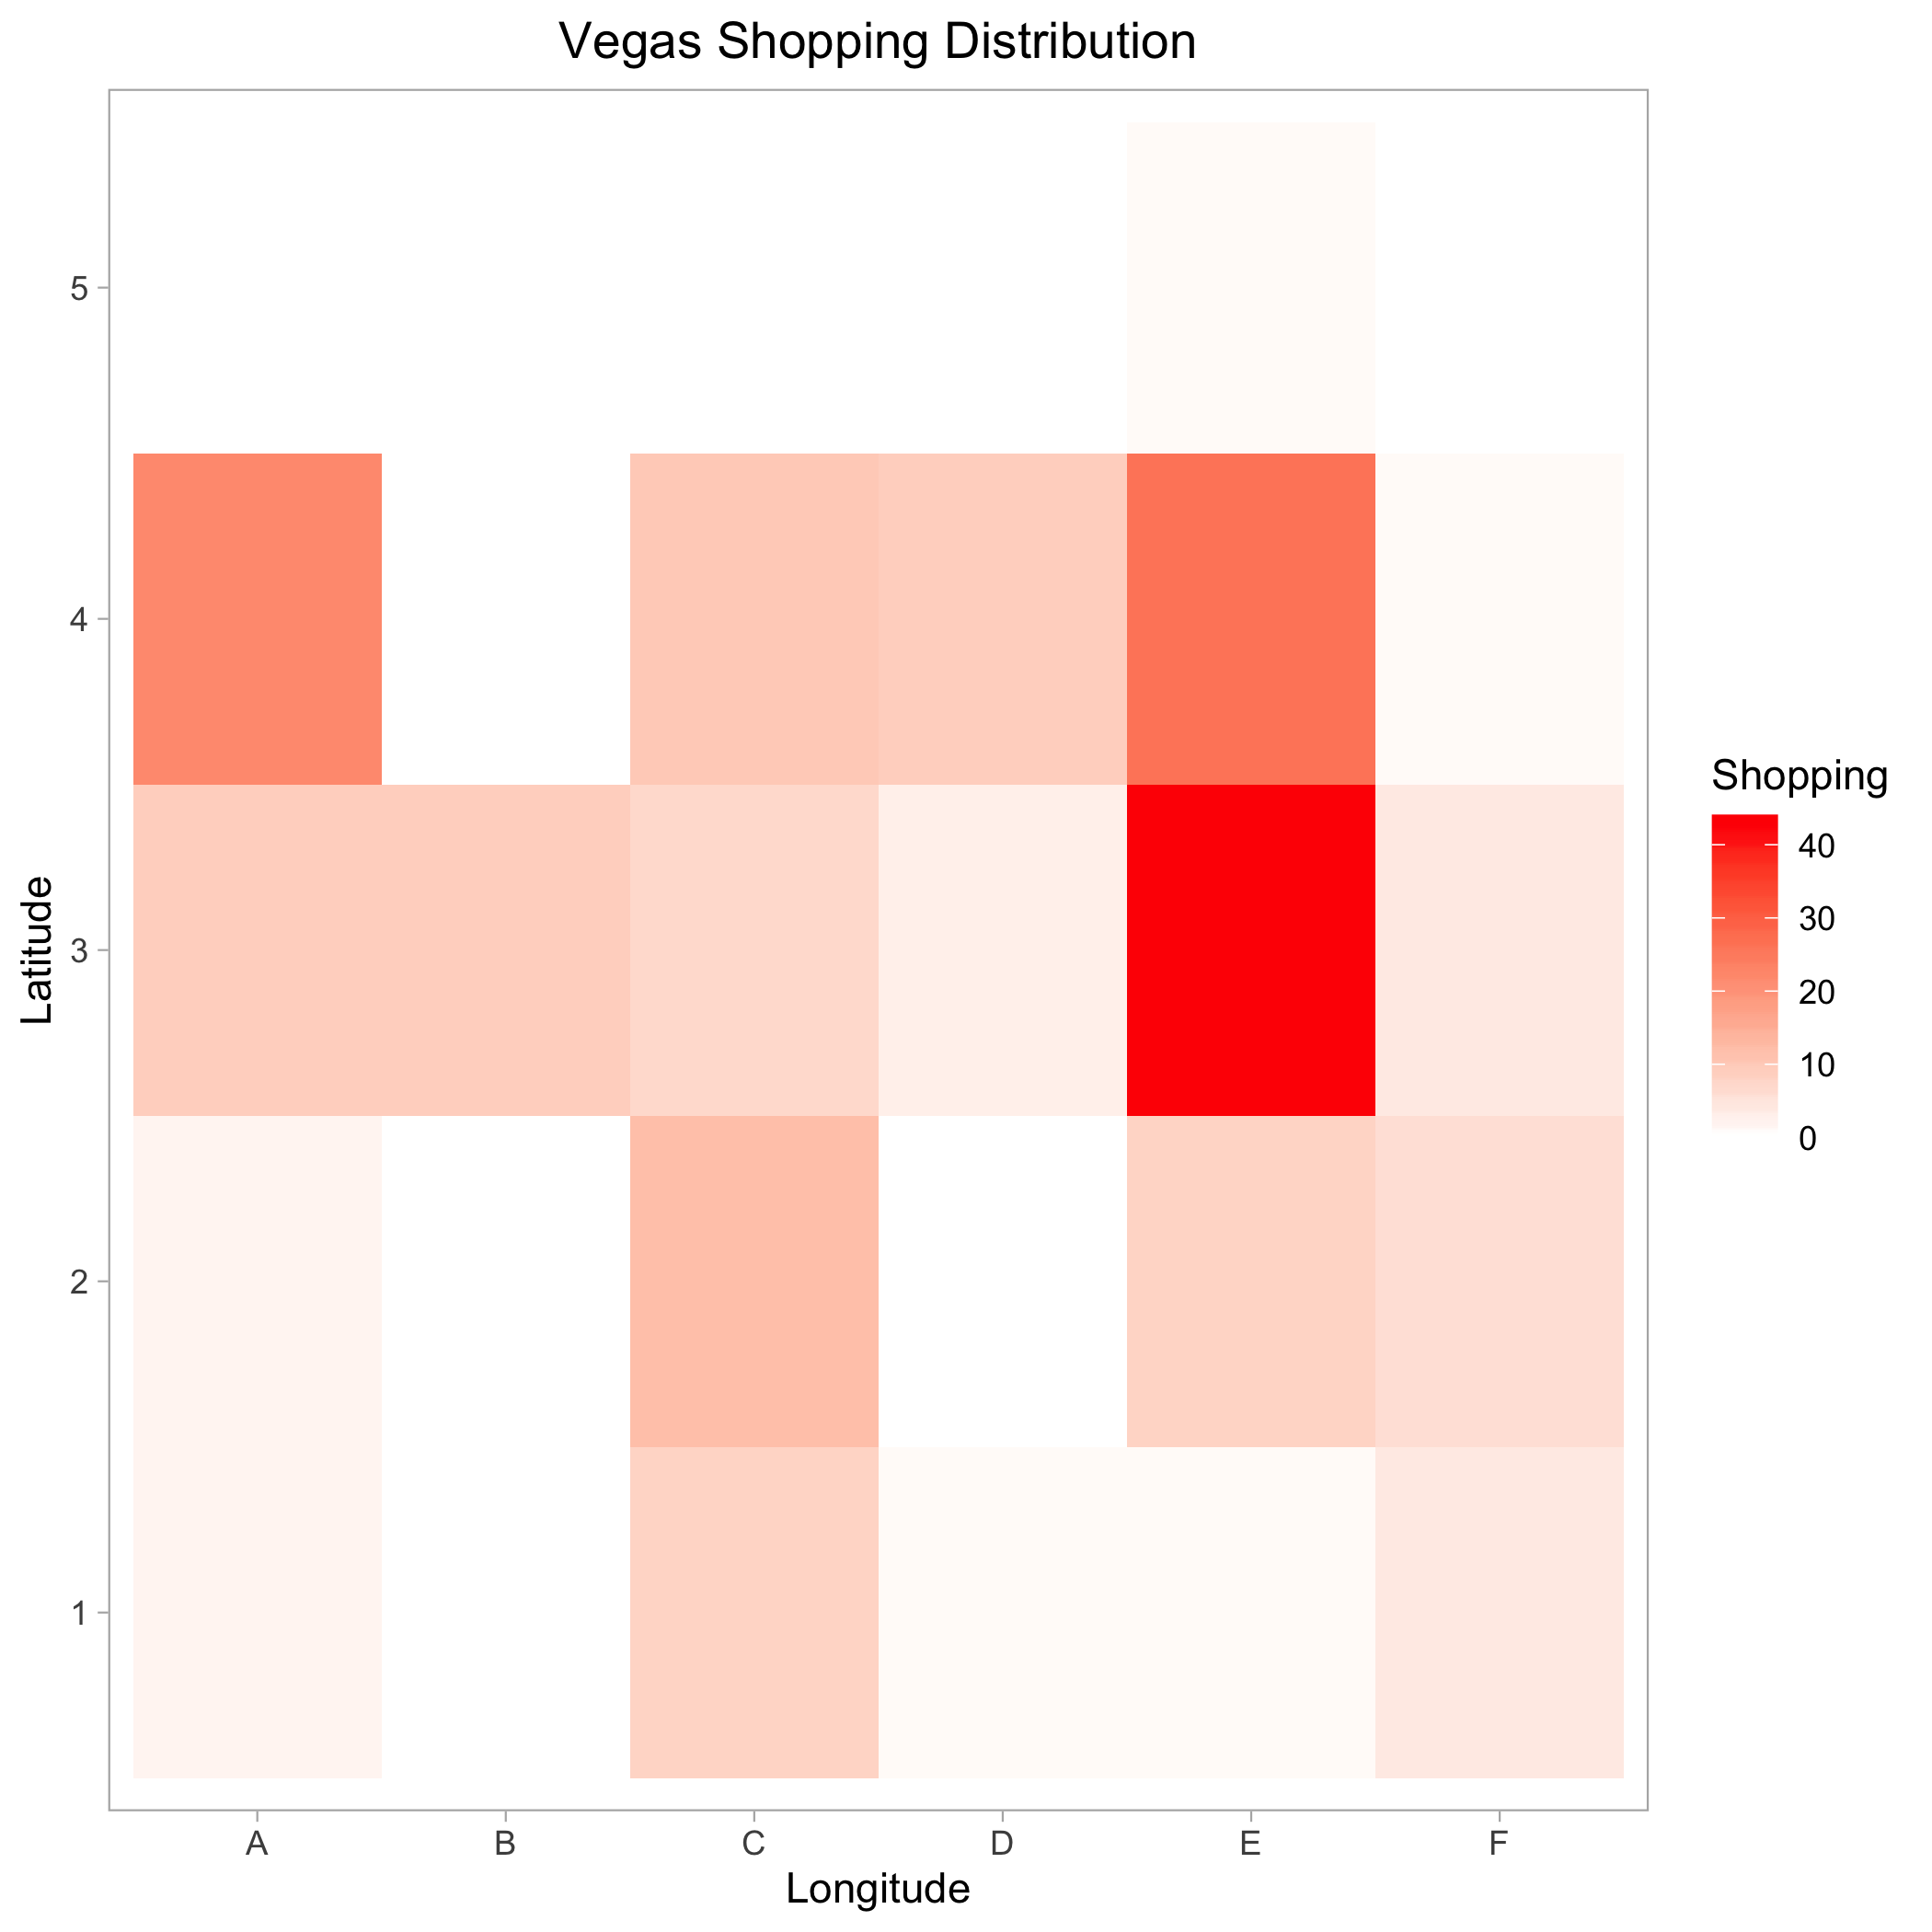
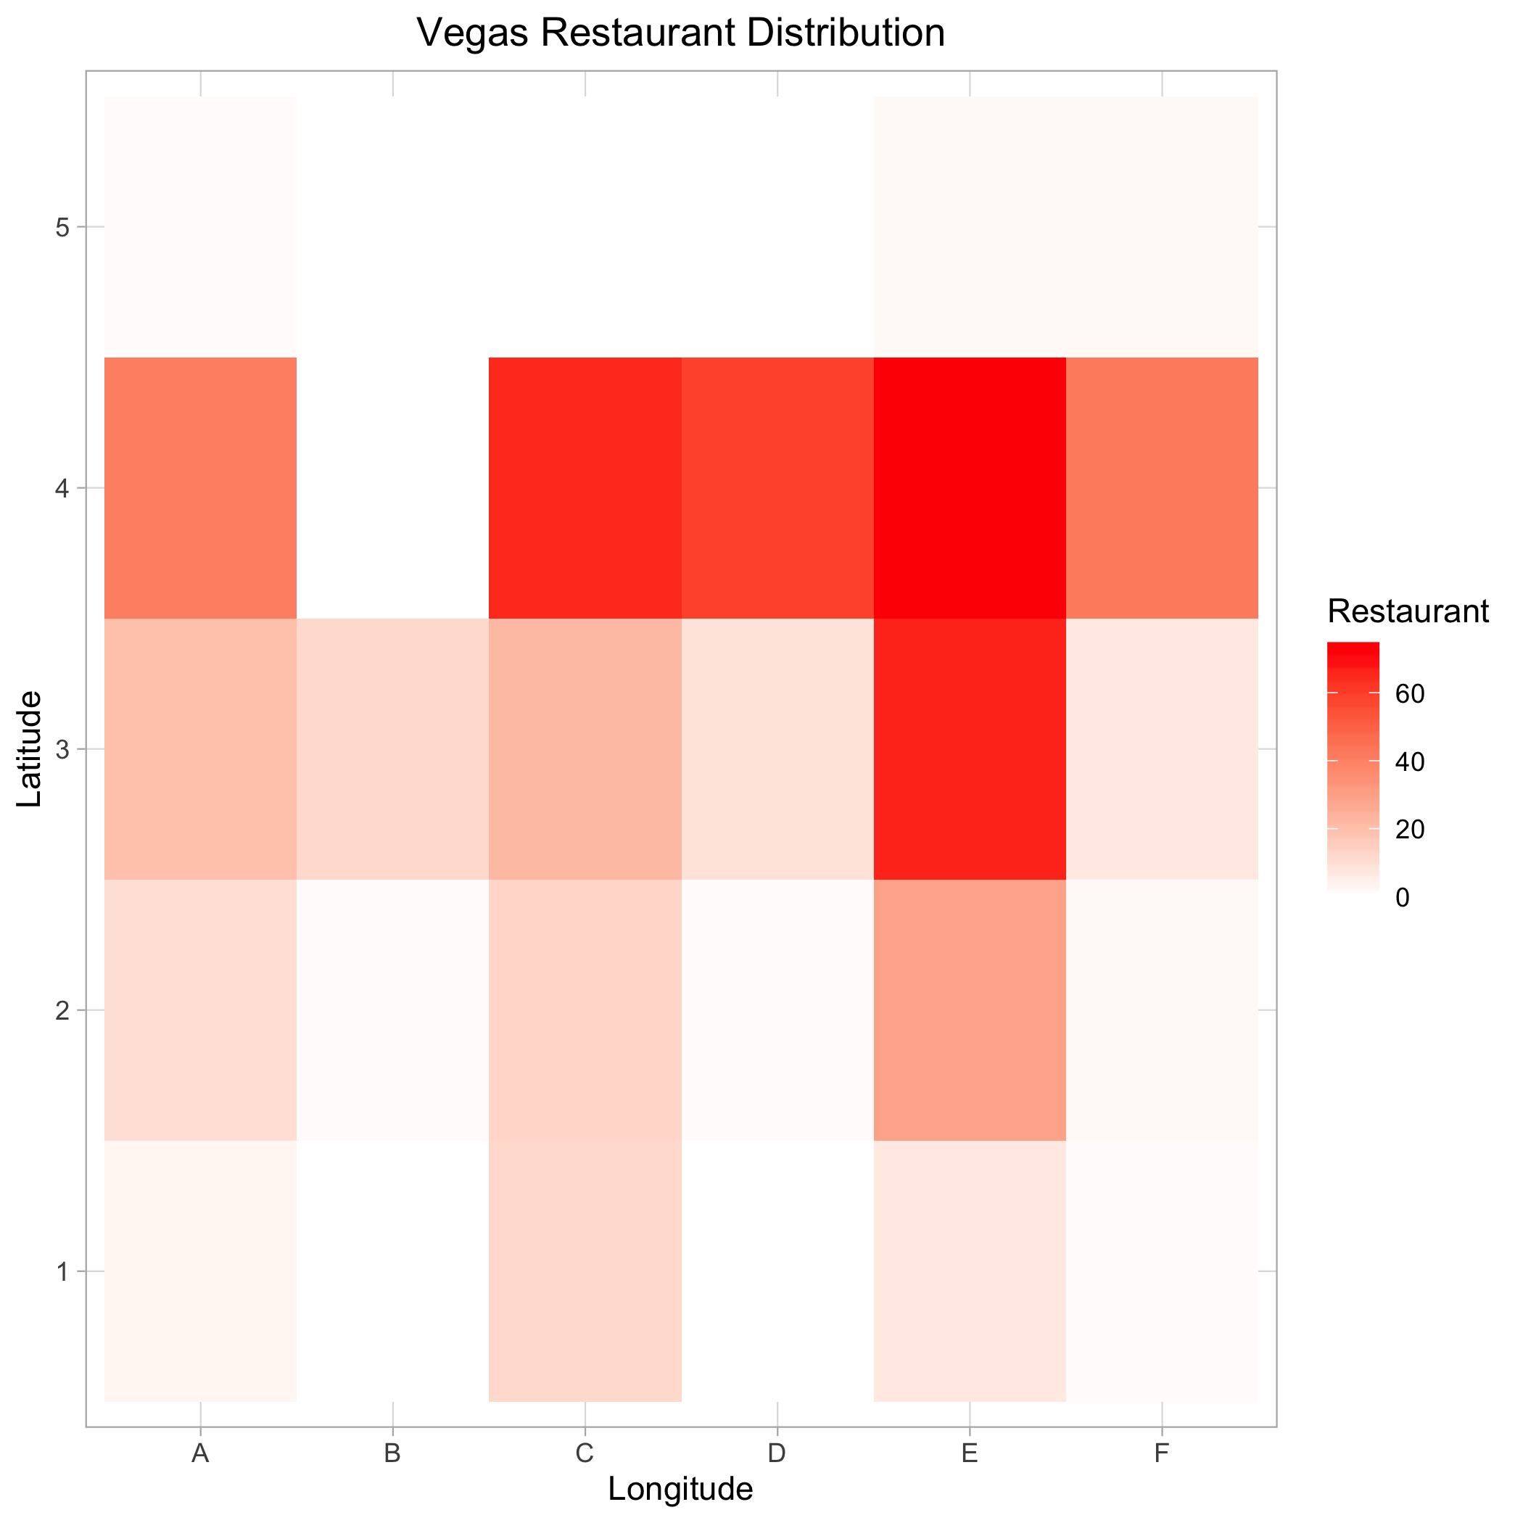


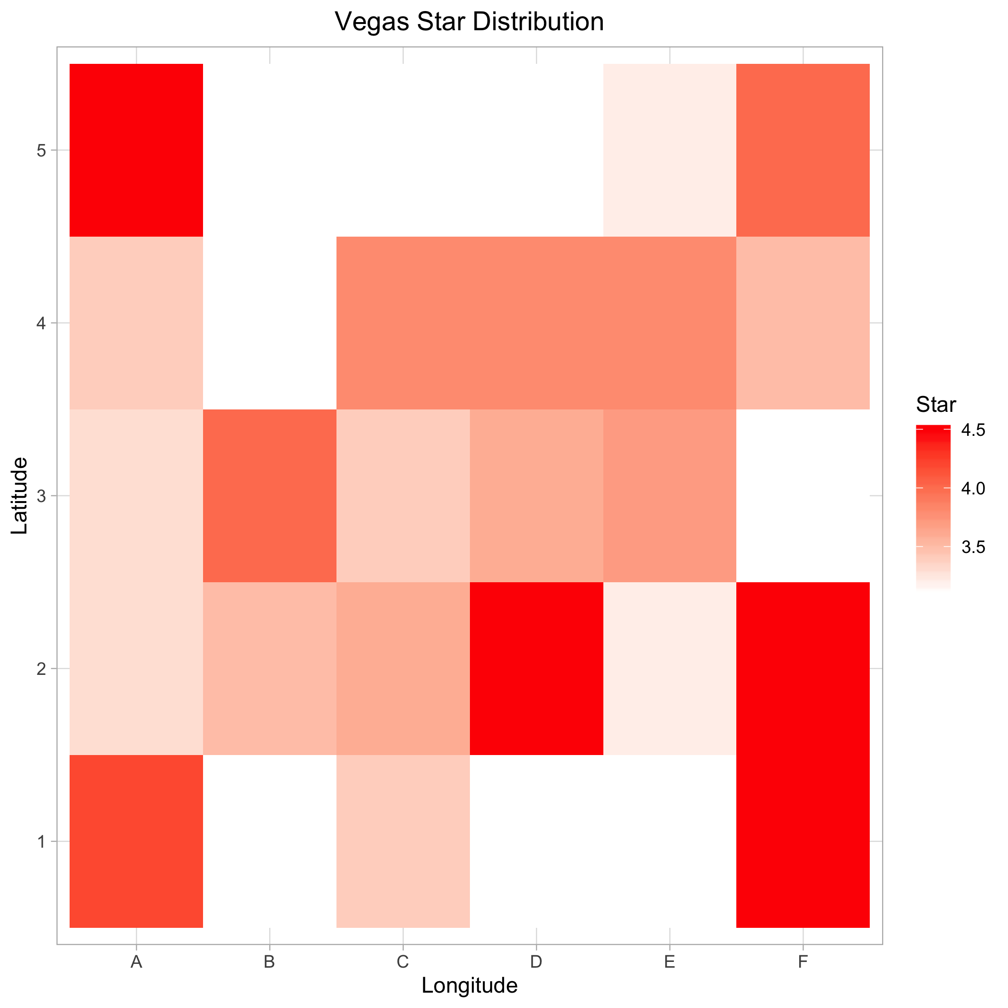
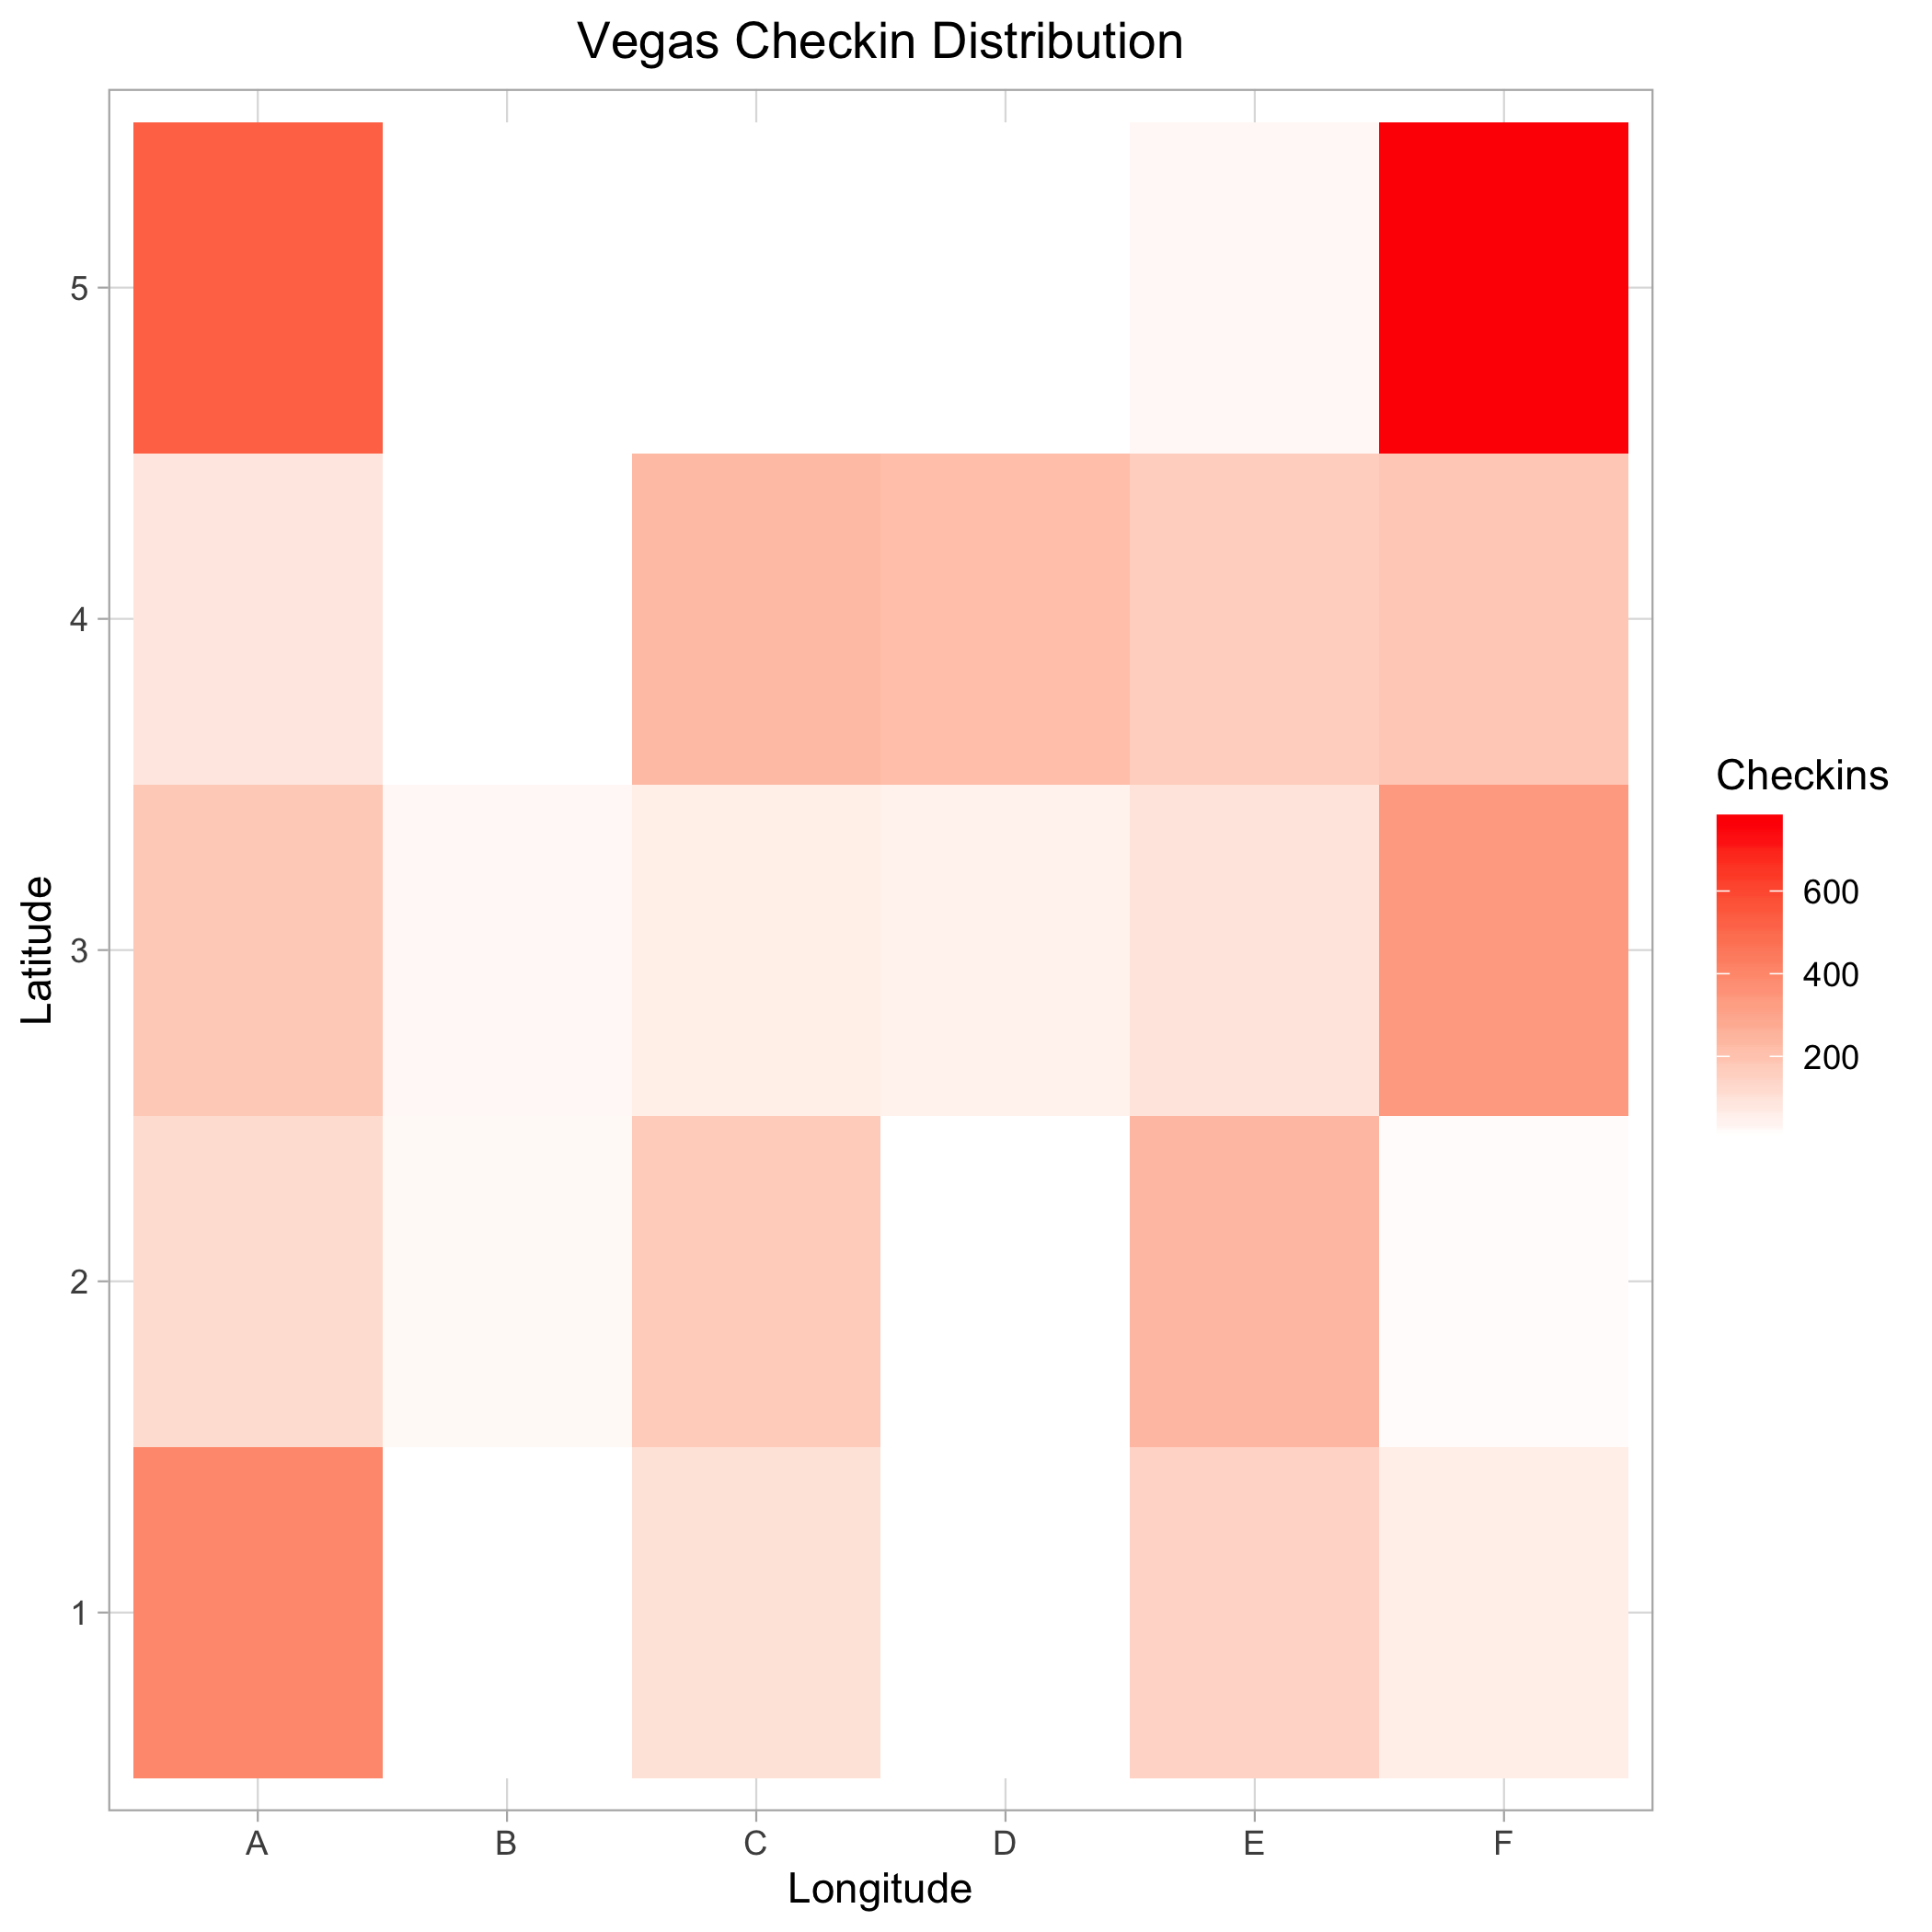


1.
2.
3.
4.

Slide 12
Raster Analysis: Las Vegas
A
B
C
D
E
F
5
4
3
2
1
Shopping Hubs
Restaurant Hubs
Highest Stars
Highest Check-ins

Slide 13
Raster Analysis: Las Vegas
A
B
C
D
E
F
5
4
3
2
1
Shopping Hubs
Restaurant Hubs
Highest Stars
Highest Check-ins

Slide 14
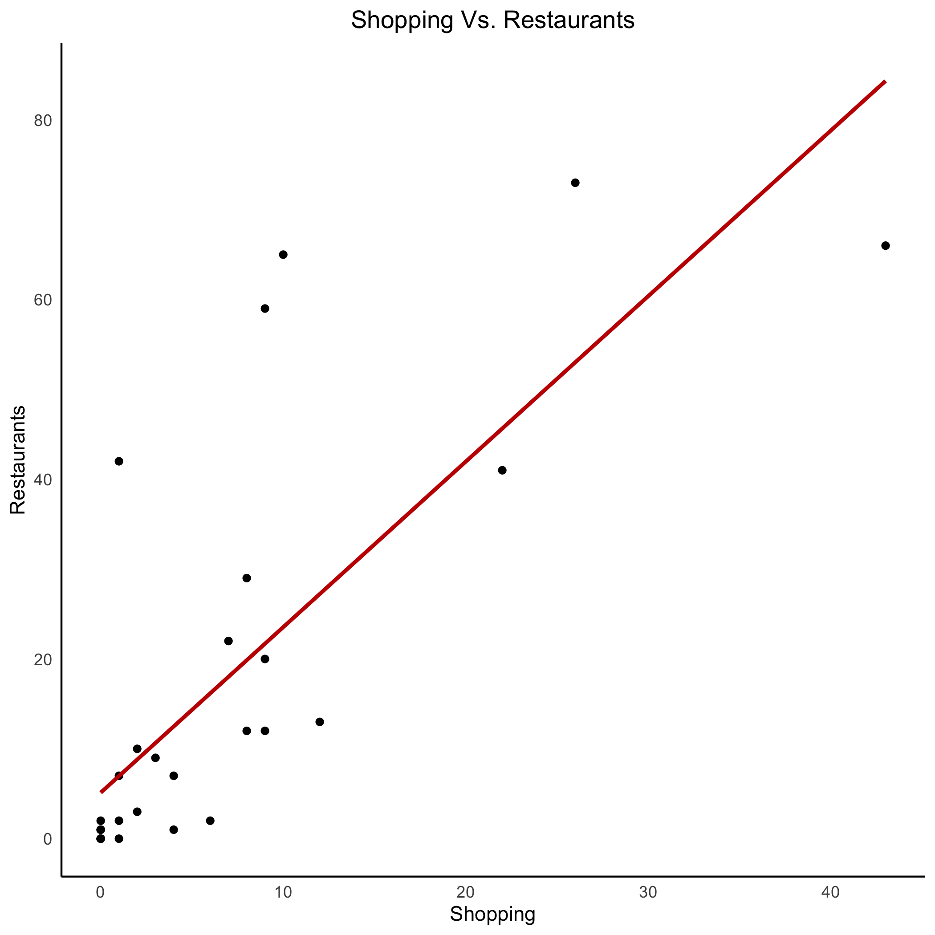
Restaurants vs shopping hubs
In general, restaurants tend to be cluttered around shopping hubs.

Slide 15
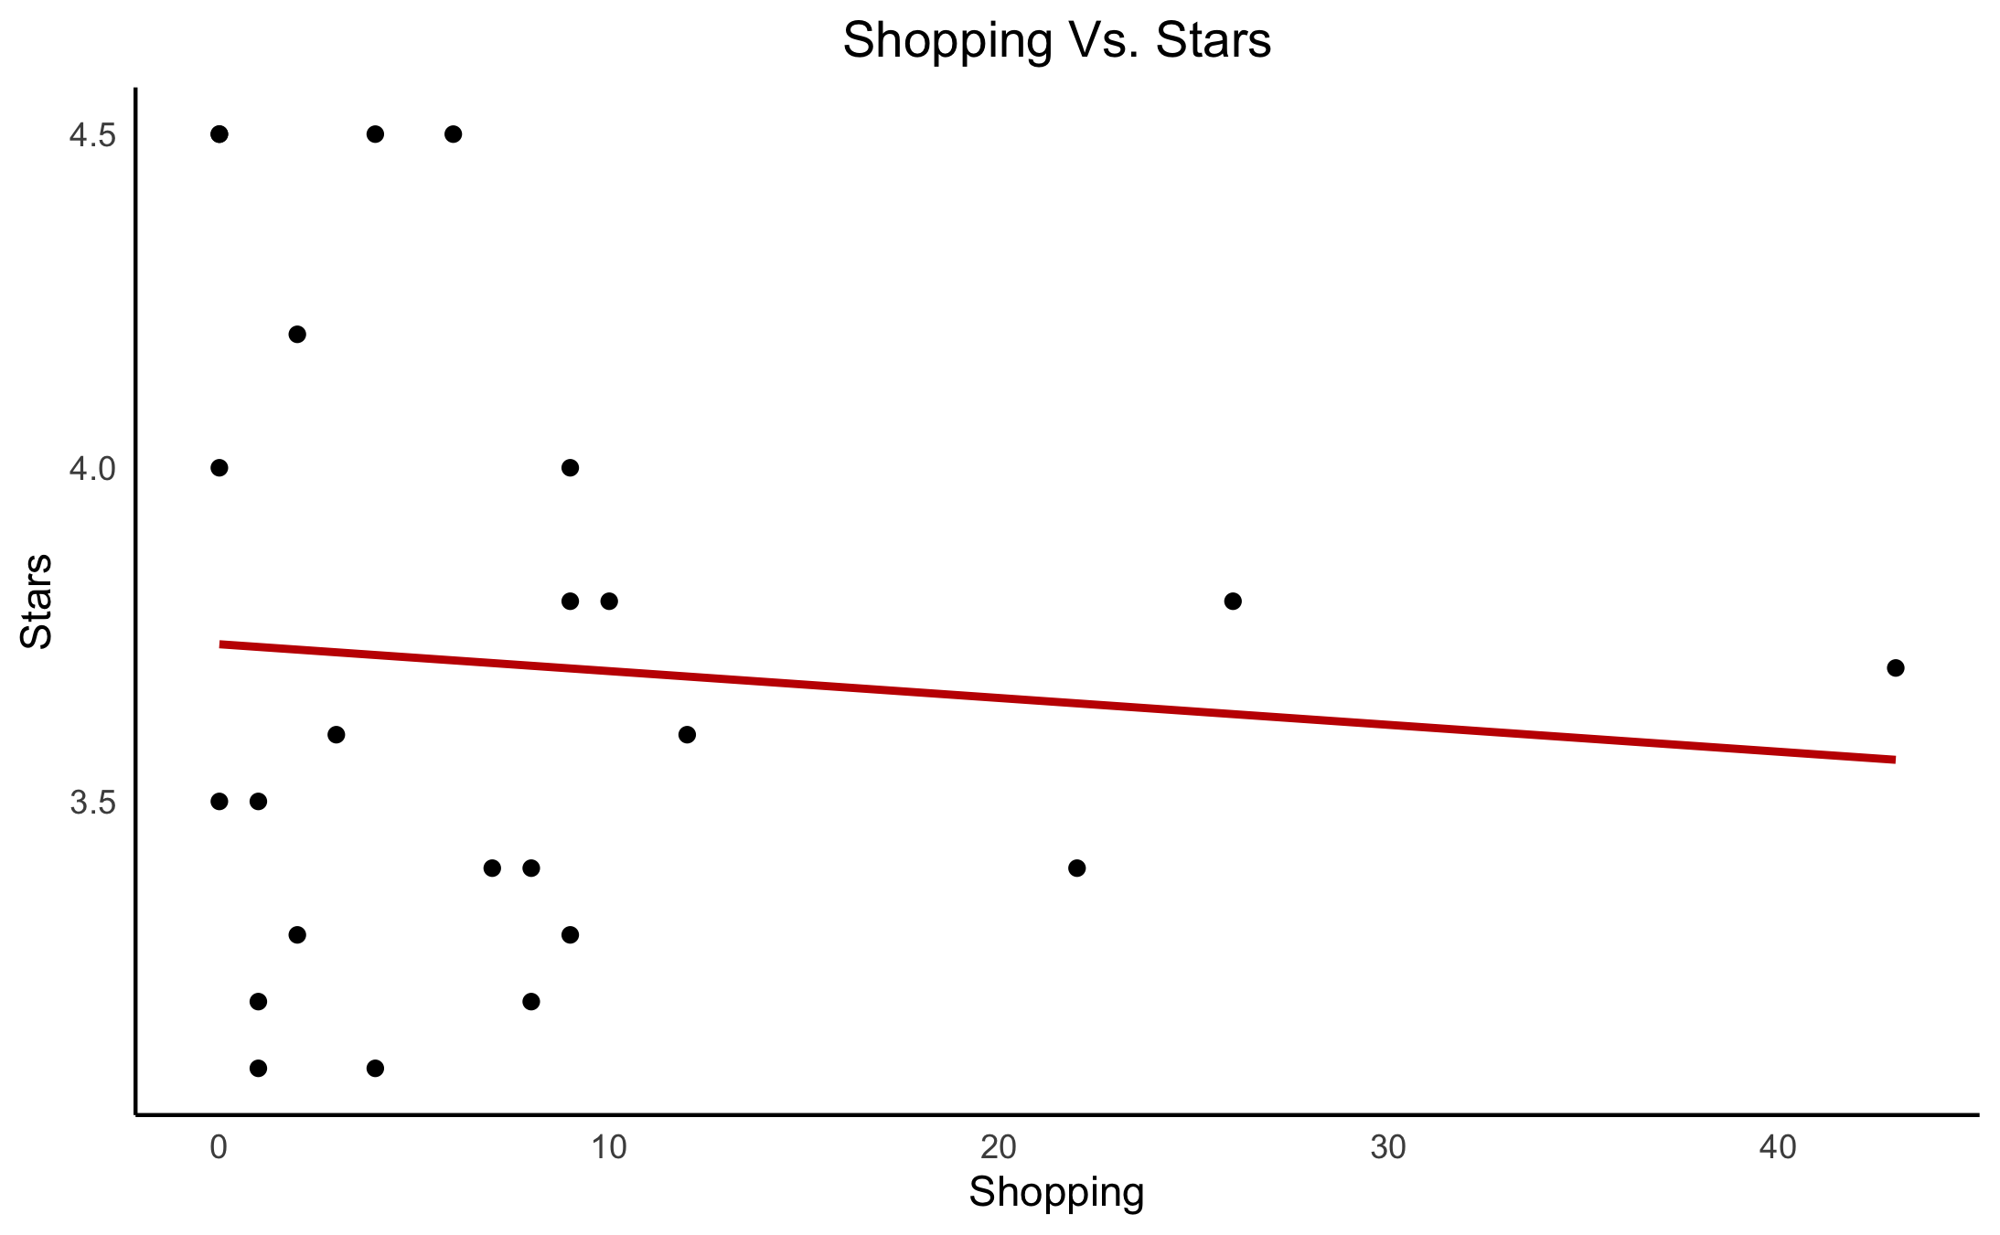
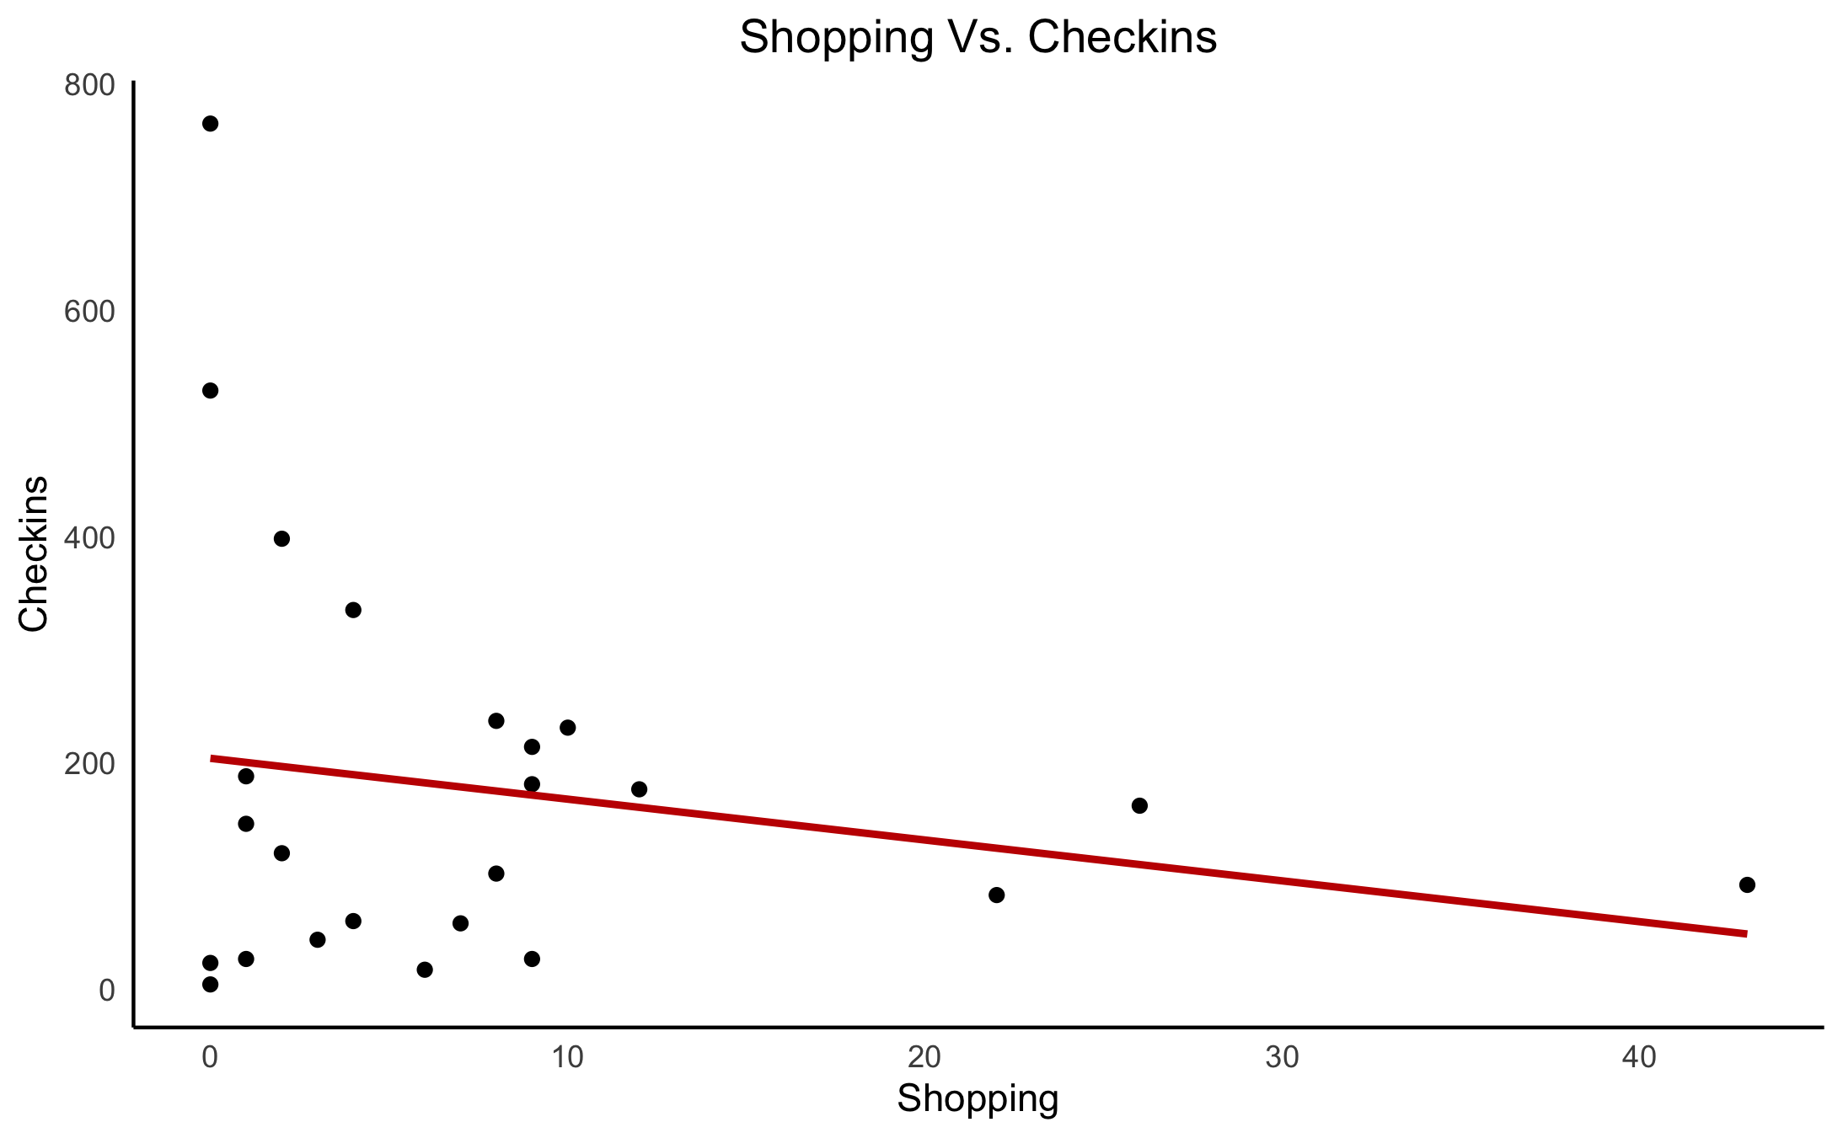
Stars & check-ins vs shopping hubs
Average star rating and number of check-ins tend to decrease with more shopping centers

Slide 16
HOURS?

Slide 17
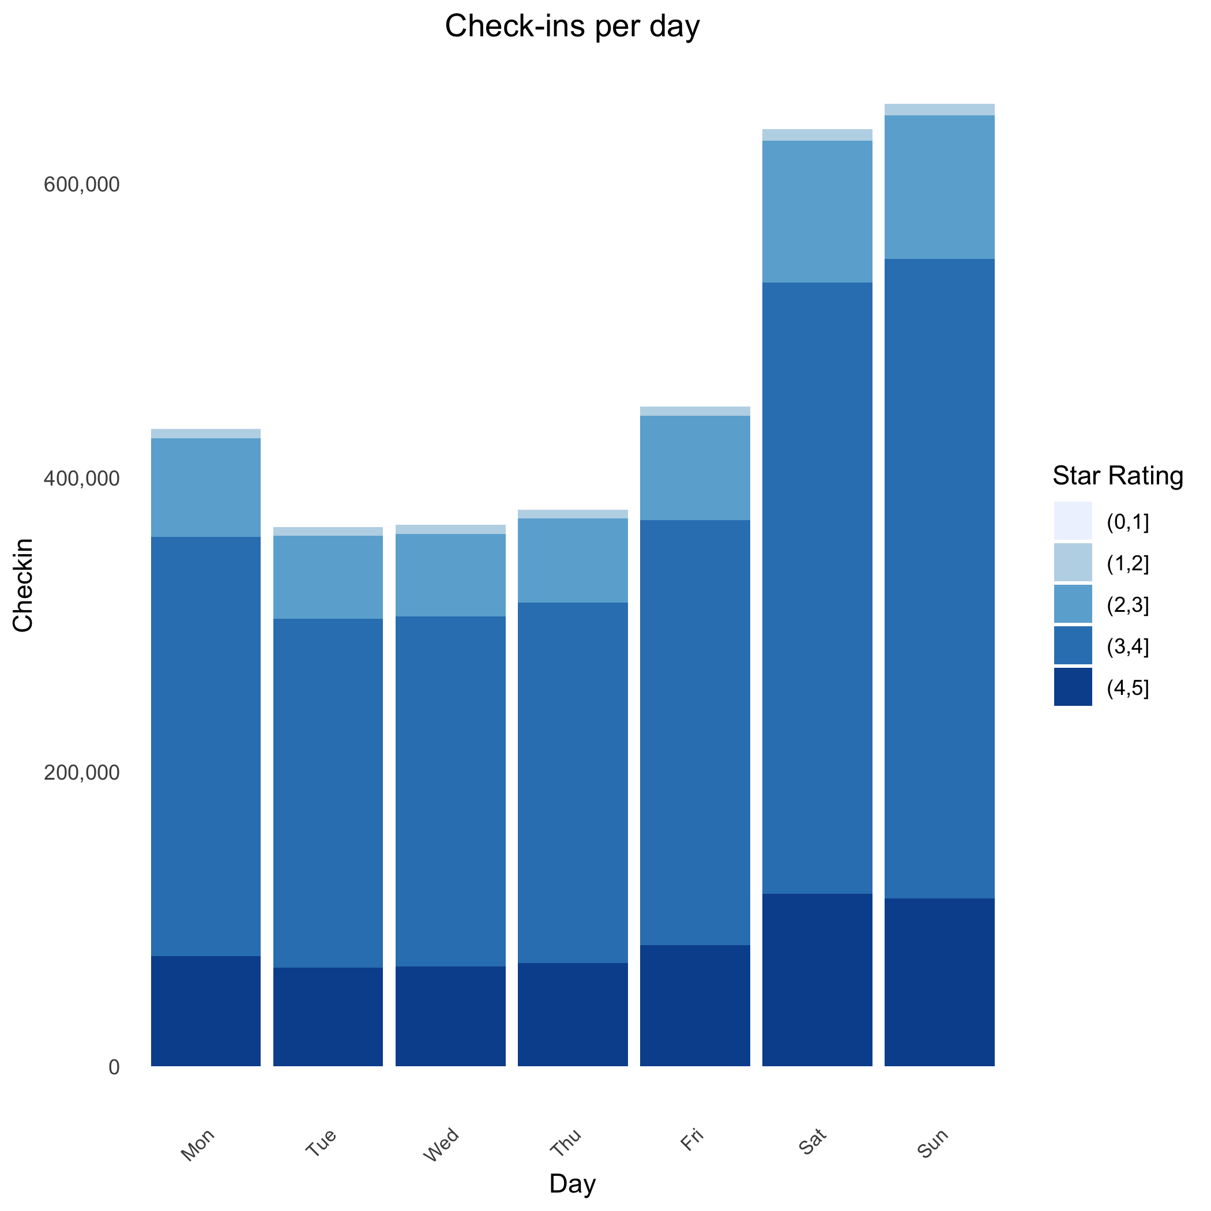
Weekly check-ins
On average, weekends have ~62% more check-ins than weekdays.

Slide 18
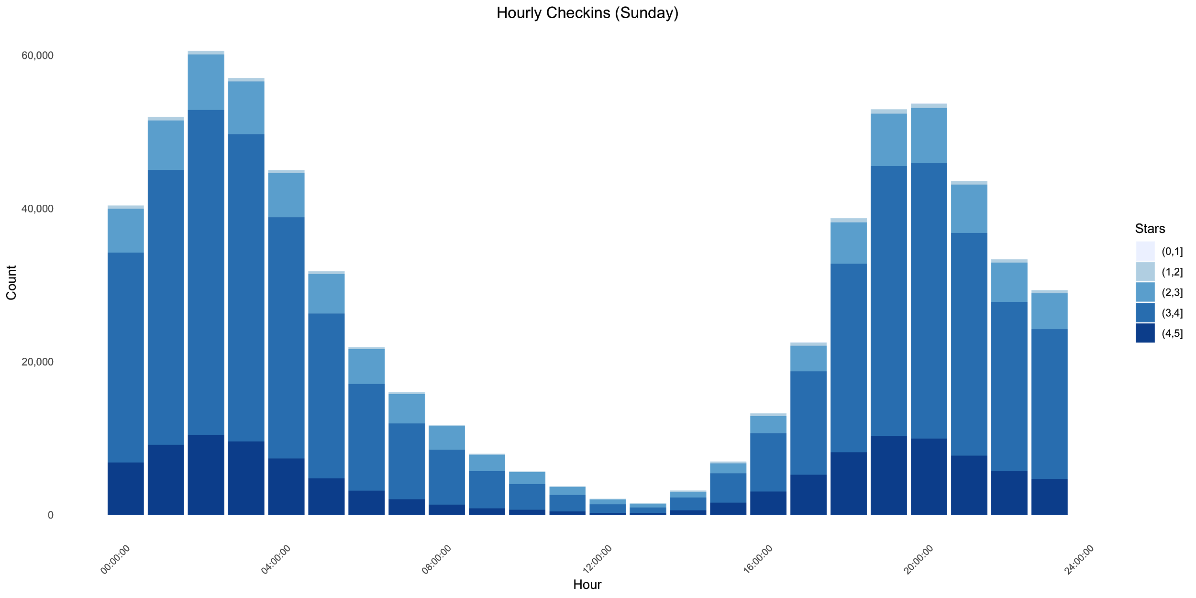
Sunday check-ins

Slide 19
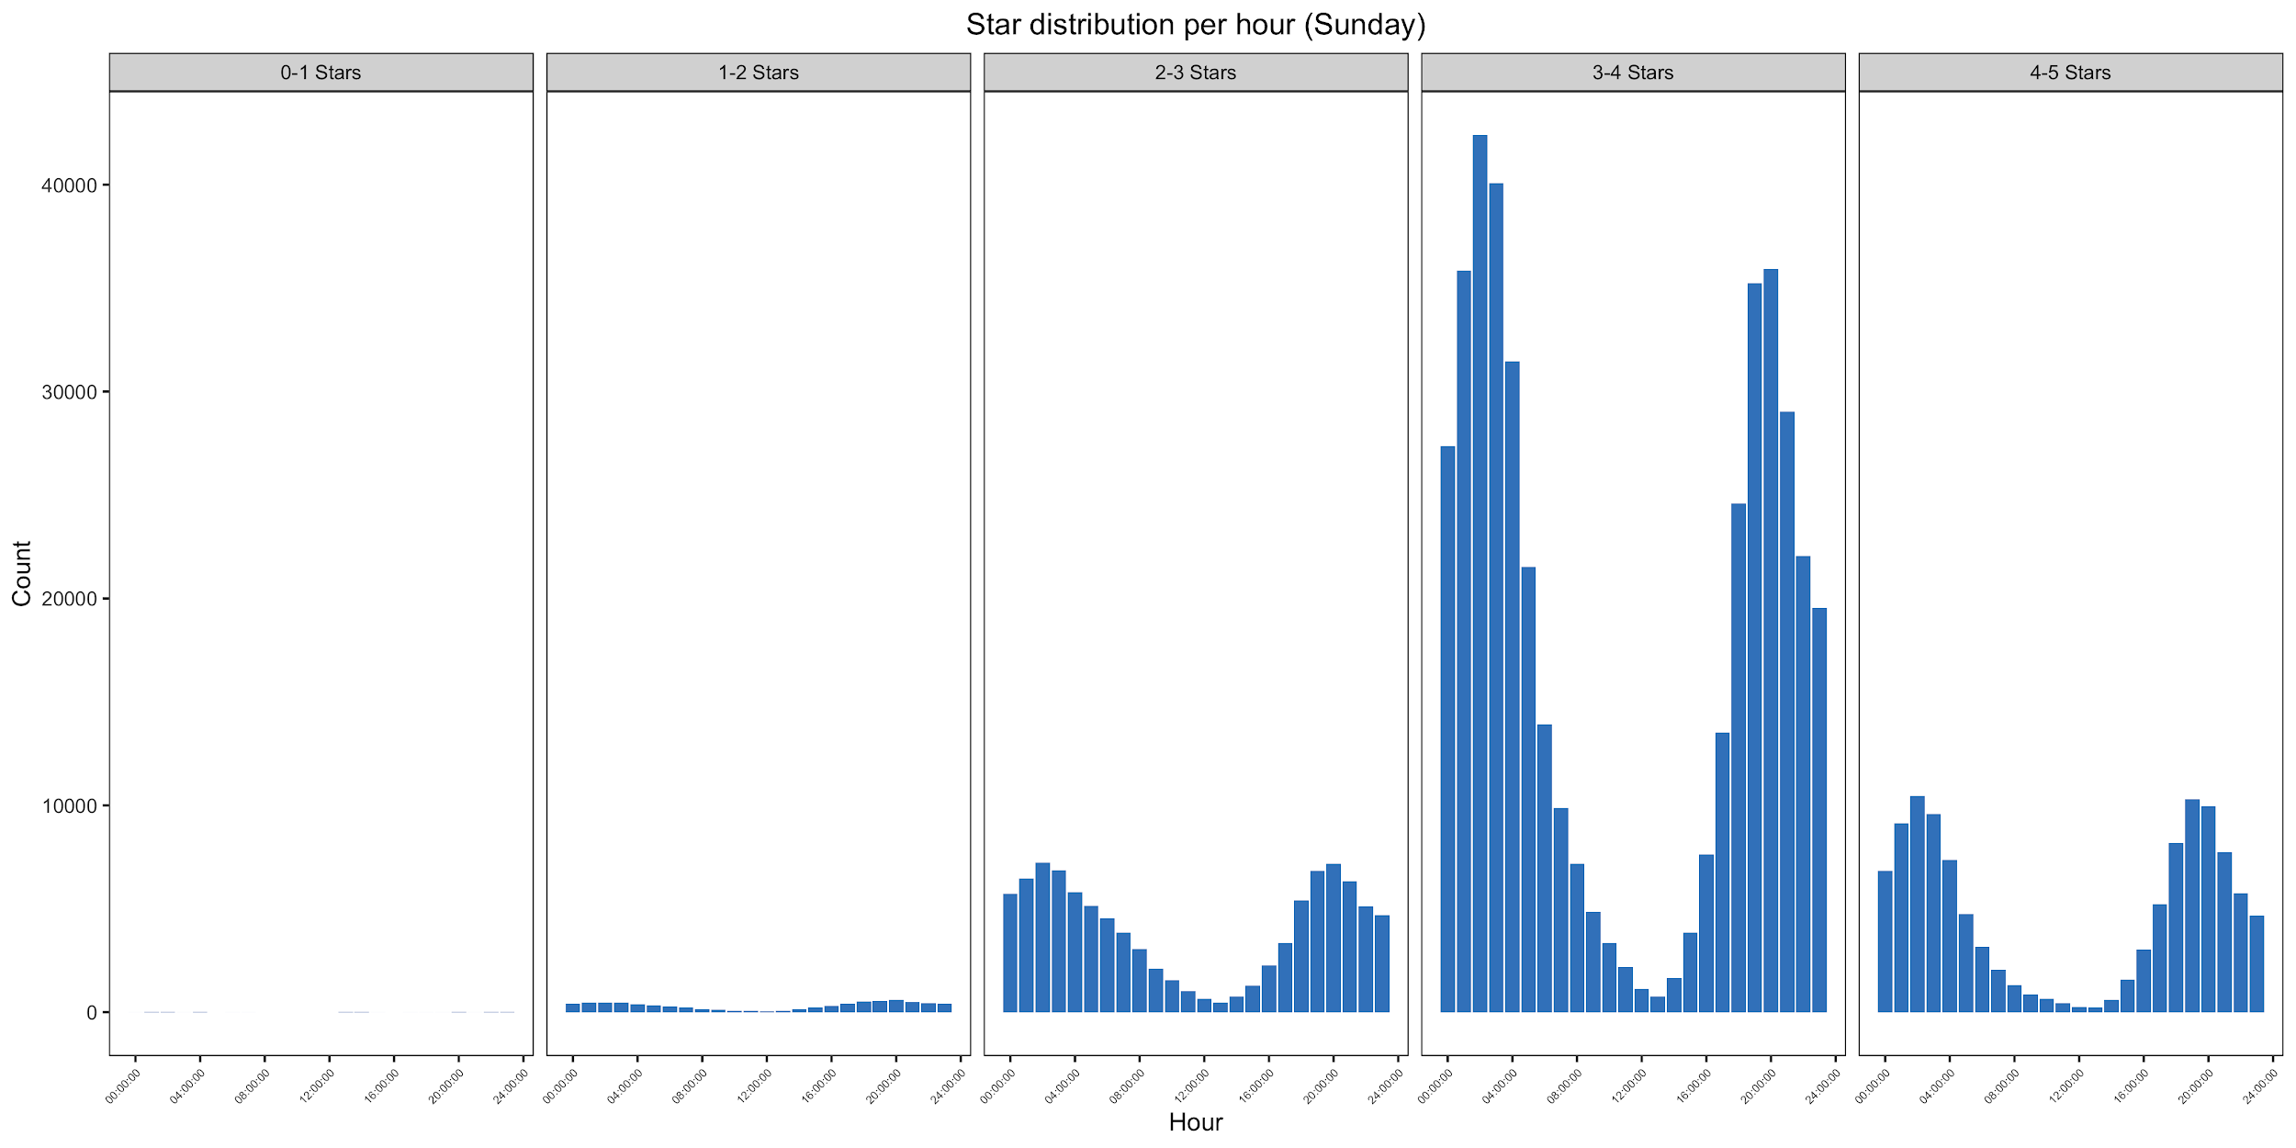
Star distribution for Sunday

Slide 20
RECOMMENDATIONS

Slide 21
Location & Hours of Operation
Restaurant’s "success" = average stars (ratings out of five) and total check-ins
The location of the restaurant should be at least 1 km away from a shopping hub.
The restaurant should definitely be open on weekends (especially Sunday) very early in the morning and late at night.

Slide 22
THANK YOU!

